Slide 1
2 Corinthians 2:12 – 3:6

Slide 2
¹² When I came to Troas to preach the gospel of Christ, even though a door was opened for me in the Lord, ¹³ my spirit was not at rest because I did not find my brother Titus there. So I took leave of them and went on to Macedonia.
¹⁴ But thanks be to God, who in Christ always leads us in triumphal procession, and through us spreads the fragrance of the knowledge of him everywhere. ¹⁵ For we are the aroma of Christ to God among those who are being saved and among those who are perishing, ¹⁶ to one a fragrance from death to death, to the other a fragrance from life to life. Who is sufficient for these things? ¹⁷ For we are not, like so many, peddlers of God’s word, but as men of sincerity, as commissioned by God, in the sight of God we speak in Christ.

Slide 3
3 Are we beginning to commend ourselves again? Or do we need, as some do, letters of recommendation to you, or from you? ² You yourselves are our letter of recommendation, written on our hearts, to be known and read by all. ³ And you show that you are a letter from Christ delivered by us, written not with ink but with the Spirit of the living God, not on tablets of stone but on tablets of human hearts.
⁴ Such is the confidence that we have through Christ toward God. ⁵ Not that we are sufficient in ourselves to claim anything as coming from us, but our sufficiency is from God, ⁶ who has made us sufficient to be ministers of a new covenant, not of the letter but of the Spirit. For the letter kills, but the Spirit gives life.

Slide 4
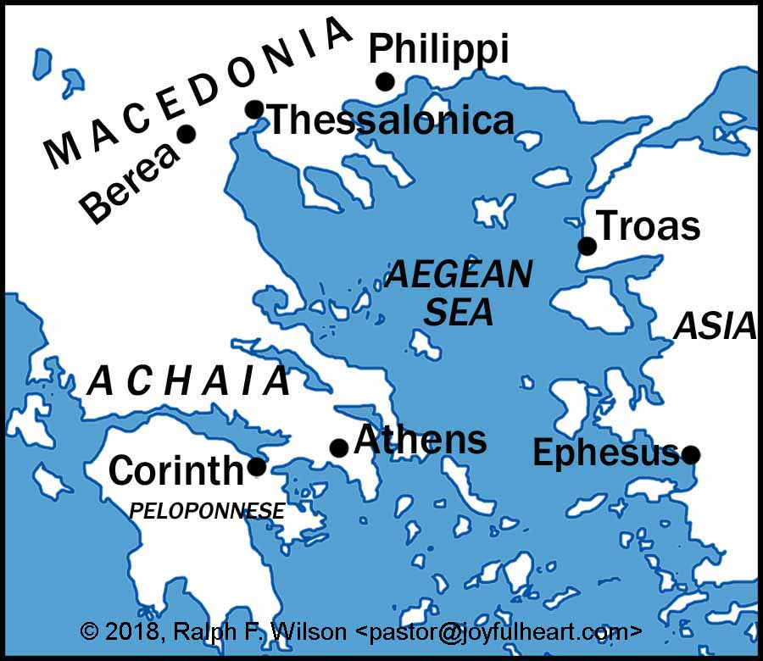

Slide 5
Despite tough times in ministry, Paul spills over in Praise for God
¹⁴ But thanks be to God, who in Christ always leads us in triumphal procession, and through us spreads the fragrance of the knowledge of him everywhere.
God leads in victory. We were enemies, but now loyal subjects.
Wherever his disciples go, the Gospel is preached.
To those who are being saved, the Gospel is a sweet smell of life to life
To those who are perishing, the Gospel is the smell of death to death
The Test of the Genuineness of the Teacher / preacher
¹⁷ For we are not, like so many, peddlers of God’s word, but as men of sincerity, as commissioned by God, in the sight of God we speak in Christ.
The temptation is to change the Gospel, to make it more appealing
Genuine teachers are sincere; commissioned by God; Overseen by God

Slide 6
Despite tough times in ministry, Paul spills over in Praise for God
God leads in victory. We were enemies, but now loyal subjects.
Wherever his disciples go, the Gospel is preached.
To those who are being saved, the Gospel is a sweet smell of life to life
To those who are perishing, the Gospel is the smell of death to death
The Test of the Genuineness of the Teacher / preacher
¹⁷ For we are not, like so many, peddlers of God’s word, but as men of sincerity, as commissioned by God, in the sight of God we speak in Christ.
The temptation is to change the Gospel, to make it more appealing
Genuine teachers are sincere; commissioned by God; Overseen by God
Who is up to the task? Who is sufficient for these things???
No one is up to the task. Our sufficiency comes from God alone.

Slide 7
Matthew 7:¹⁵ “Beware of false prophets, who come to you in sheep’s clothing but inwardly are ravenous wolves. ¹⁶ You will recognize them by their fruits. Are grapes gathered from thornbushes, or figs from thistles? ¹⁷ So, every healthy tree bears good fruit, but the diseased tree bears bad fruit. ¹⁸ A healthy tree cannot bear bad fruit, nor can a diseased tree bear good fruit. ¹⁹ Every tree that does not bear good fruit is cut down and thrown into the fire. ²⁰ Thus you will recognize them by their fruits.
3 Are we beginning to commend ourselves again? Or do we need, as some do, letters of recommendation to you, or from you? ² You yourselves are our letter of recommendation, written on our hearts, to be known and read by all. ³ And you show that you are a letter from Christ delivered by us, written not with ink but with the Spirit of the living God, not on tablets of stone but on tablets of human hearts.

Slide 8
Despite tough times in ministry, Paul spills over in Praise for God
God leads in victory. We were enemies, but now loyal subjects.
Wherever his disciples go, the Gospel is preached.
To those who are being saved, the Gospel is a sweet smell of life to life
To those who are perishing, the Gospel is the smell of death to death
The Test of the Genuineness of the Teacher / preacher
¹⁷ For we are not, like so many, peddlers of God’s word, but as men of sincerity, as commissioned by God, in the sight of God we speak in Christ.
The temptation is to change the Gospel, to make it more appealing
Genuine teachers are sincere; commissioned by God; Overseen by God
Recognise false teachers by their spiritual fruit (content of their character)
And by the fruit of their preaching (transformed lives). Is the church growing closer to God and more righteous, or further away & more worldly
When a church is growing spiritually, it is entirely the work of God and His Holy Spirit
Who is up to the task? Who is sufficient for these things???
No one is up to the task. Our sufficiency comes from God alone.

